Slide 1
Identification of Novel Expressed Peptides from Human Brain: a Pilot Study
Shanzida Jahan Siddique

Slide 2
Background
What was our goal
Why mass spectrometry
Why PRIDE database
Why PGA
Future work

Slide 3
Background
Only 4.4% of the human genome actually code for protein
About half of the human genome consists of repetitive element and transposable element.
The function(s) of most of the genome remain undiscovered
Source: https://www.sciencedirect.com/science/article/pii/S2095927316302924
Notes:
The human genome contains approximately 3 billion DNA base pairs and encodes every protein produced by the human body. However, all known protein-codons in the human genome form less than three percent of the total genome.
The function(s) of most of the genome remain undiscovered
previous studies have demonstrated that at least some genomic sequences annotated as non-coding actually do produce RNA transcripts that could code for proteins
The genomes of Eukaryotes contain millions of copies of transposable elements and other repetitive sequences. Indeed, the initial sequencing and analysis of the human genome revealed that about half of the genome consists of repetitive DNA sequences
More recent Bioinformatics analysis indicate that repetitive elements (RE) in the human genome might be as high as two-thirds of the whole genome

Slide 4
REPETITIVE ELEMENT
Repeated sequences are patterns of nucleic acids that occur in multiple copies throughout the genome.
Source : https://www.mun.ca/biology/scarr/SINE.html

Slide 5
RE may be expressed and function
Source:
https://www.researchgate.net/publication/280586047_The_role_of_Alu_elements_in_the_cis-regulation_of_RNA_processing
Notes:
https://www.researchgate.net/publication/280586047_The_role_of_Alu_elements_in_the_cis-regulation_of_RNA_processing

Slide 6
Why look at brain?
Brain tissue is more likely than other tissues to express functional RNAs and proteins that are not annotated.
The transcript data predominantly comes from easily accessible cell types, such as blood or epithelial cells.
Protein isoforms specific to less well-studied cell types, such as those in human brain tissue, are therefore more likely to be missing from the official annotations.
In addition, RNA sequencing of 29 solid organ tissues and 11 brain sub-regions from 175 individuals, revealed that in the brain, unlike most organs, splicing is the major driver of cellular specificity, rather than transcript abundance
This finding suggests that any novel splicing isoforms that are discovered in the brain are likely to be functionally important.

Slide 7
Expression of repetitive elements (RE) in the orbitofrontal cortex
Despite the high abundance of RE in human genome, they are mostly excluded from different genomic, epigenetic and RNA expression studies
Previous studies by Miranda et al demonstrate abundant expression of RE in the human brain cortex and about 10% of the RNA sequencing reads were originated from a RE
They performed a thorough characterization of expressed RE using directional RNA-seq data generated using orbitofrontal cortex samples from 59 human subjects.
were able to measure the transcription from each annotated RE by counting the RNA-seq reads that aligned to each locus.
They took advantage of the sequence differences between loci that were created by their accumulated mutations, and measured the transcription from each RE by counting only the sequencing reads that map uniquely to each locus rather than anywhere else in the genome. We discovered that more than 30,000 of them are consistently expressed across individuals: 14,055 were in annotated exons, 7,228 were in annotated introns, and 10,405 were in intergenic regions

Slide 8
Some RE make novel Exons in Brain

Slide 9
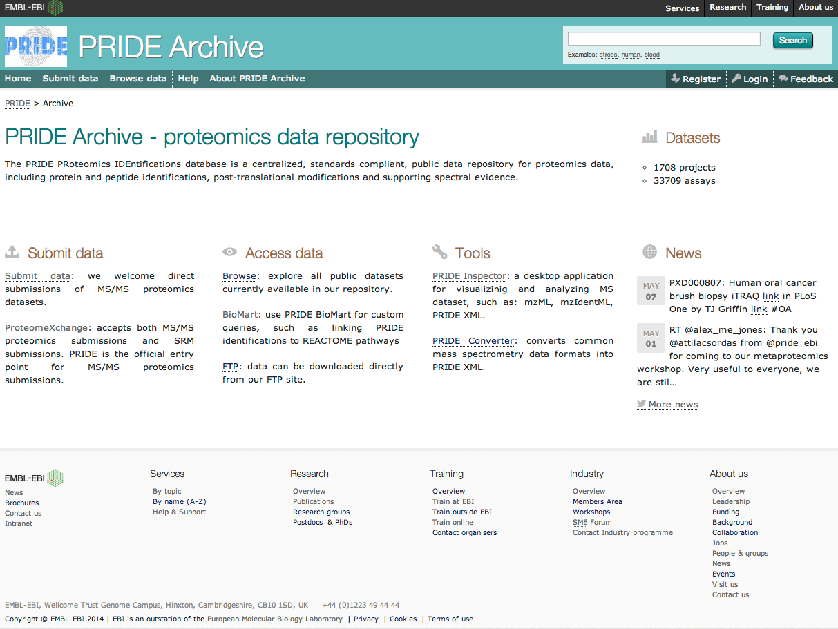

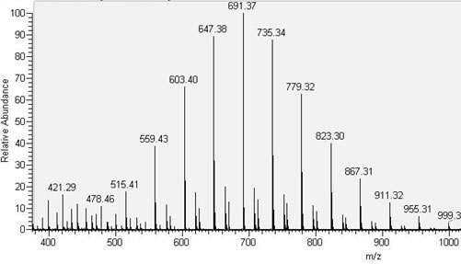
PRIDE (PRoteomics IDEntifications) database
PRIDE stores mass spectrometry (MS)-based proteomics data:
Peptide and protein expression data (identification and quantification)
Post-translational modifications
Mass spectra (raw data and peak lists)
Technical and biological metadata
Any other related information
Full support for tandem MS approaches
http://www.ebi.ac.uk/pride
Martens et al., Proteomics, 2005
Vizcaíno et al., NAR, 2013

Slide 10




ProteomeXchange Consortium
Goal: Development of a framework to allow standard data submission and dissemination pipelines between the main existing proteomics repositories.
Includes PeptideAtlas (ISB, Seattle), PRIDE (Cambridge, UK) and MassIVE (UCSD, San Diego).
Tranche and Peptidome initially included but discontinued.
Common identifier space (PXD identifiers)
Two supported data workflows: MS/MS and SRM.
Main objective: Make life easier for researchers
http://www.proteomexchange.org
Vizcaíno et al., Nat Biotechnol, 2014

Slide 11

ProteomeXchange data workflow: PRIDE
Receiving repositories
Peptide Atlas
PRIDE
(MS/MS data)
Results
MassIVE
(MS/MS data)
ProteomeCentral
Raw Data*
UniProt/
neXtProt
Metadata / Manuscript
PASSEL
(SRM data)
Other DBs
Researcher’s results
Reprocessed results
Journals
GPMDB
Other DBs
Raw data*
Metadata
Vizcaíno et al., Nat Biotechnol, 2014

Slide 12


PX Data workflow for MS/MS data
Mass spectrometer output files: raw data (binary files) or peak list spectra in a standardized format (mzML, mzXML).
Result files:
Complete submissions: Result files can be converted to PRIDE XML or the mzIdentML data standard.
Partial submissions: For workflows not yet supported by PRIDE, search engine output files will be stored and provided in their original form.
Metadata: Sufficiently detailed description of sample origin, workflow, instrumentation, submitter.
Other files: Optional files:
QUANT: Quantification related results e. FASTA
PEAK: Peak list files f. SP_LIBRARY
GEL: Gel images
OTHER: Any other file type
Published
Raw
Files
Other files

Slide 13
How do we know if they are translated?
Talk about what is available in Pride…

Slide 14
Datasets Submission Rate in PRIDE
Source :https://pdfs.semanticscholar.org/948f/d800ecdd3c99488dde36b41480ca1b8acce3.pdf?_ga=2.103574656.1648217994.1567678077-946751234.1560755147
Notes:
https://pdfs.semanticscholar.org/948f/d800ecdd3c99488dde36b41480ca1b8acce3.pdf?_ga=2.103574656.1648217994.1567678077-946751234.1560755147

Slide 15
PRIDE :THE PROTEOMICS IDENTIFICATION DATABASE
Source: https://pdfs.semanticscholar.org/948f/d800ecdd3c99488dde36b41480ca1b8acce3.pdf?_ga=2.103574656.1648217994.1567678077-946751234.1560755147

Slide 16
Workflow for Discovery of novel peptides from RNA seq Data
Make FASTA file from RNA seq dataset which obtained from Human brain samples
Step-1:
Step-2:
Translate into Six Frame protein sequence by PGA
Step-3:
Collect proteomics data from PRIDE database
Step-4:
Search PRIDE dataset against PGA predicted peptides

Slide 17
PGA: an R/Bioconductor package for identification of novel peptides using a customized database derived from RNA-Seq
Source : https://www.ncbi.nlm.nih.gov/pmc/articles/PMC4912784/

Slide 18
PXD006537:Large Cohort Proteomics Profiling of Human Brain Cortex
Title: Large Cohort Proteomics Profiling of Human Brain Cortex
Description : LC-MS/MS profiling of mid frontal or inferior temporal cortex from ROS, MAP and KRONOSII cohorts.
Sample Processing Protocol :Samples were digested with trypsin, labeled with O18, then analyzed by LC-MS/MS
Data Processing Protocol : Data was processed using SIPPER (Stable Isotope Probing Protein Extraction Resources software), PubMed ID 24467184
Submission Date:09/05/2019
Publication Date:13/05/2019
SUBMITTER: Matthew Monroe
LAB HEAD: Vlad Petyuk
PROVIDER: PXD006537 | Pride | 2019-05-13
REPOSITORIES: Pride

Slide 19
The human brainome: network analysis identifies HSPA2 as a novel Alzheimer’s disease target
Published in BRAIN a journal of Neurobioloy
Examined how proteins are incorporated into networks in two separate series and evaluated the outputs in two different cell lines.
pipeline included the following steps: (i) predicting expression quantitative trait loci; (ii) determining differential expression; (iii) analysing networks of transcript and peptide relationships; and (iv) validating effects in two separate cell lines.
Performed all the analysis in two separate brain series to validate effects.
two series included 345 samples in the first set (177 controls, 168 cases; age range 65–105; 58% female; KRONOSII cohort) and 409 samples in the replicate set (153 controls, 141 cases, 115 mild cognitive impairment; age range 66–107; 63% female; RUSH cohort).

Slide 20
PXD006537:Large Cohort Proteomics Profiling of Human Brain Cortex
Dataset: Alz_P01_A01_097_26Apr12_Roc_12-03-15.mgf
Alz_P01_A01_097 H 9 1a ROS_20974481 97 FCTX F 15.7 28 ROS 20974481 A
Gender: Female
Sample group:ROS
Site:15.7

Slide 21
Two Novel Peptides Found After Running PGA
peptide | protein
QNSSDTGLKK | chr2:242158044-242158231_+::::ANO7|+|F2|1;chr2:242158049-242158231_+::::ANO7|+|F3|1
VFQLIGCVCHGEG | chr7:74158458-74158589_+::::GTF2I|+|F3|1;chr7:74158477-74158589_+::::GTF2I|+|F2|1

Slide 22
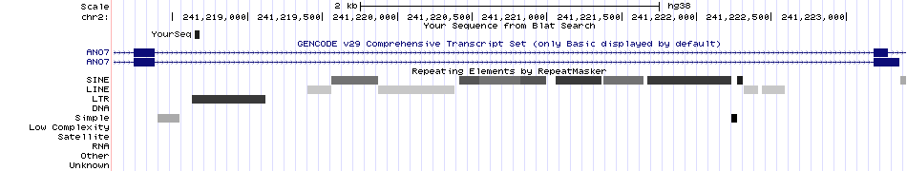
Visualization of novel peptide found in ANO7 gene
QNSSDTGLKK
GTGTAGCAGGACGAGTCGCAGACAGAACTCCTCAGACACCGGATTAAAGAAGGAAGAGGTTTTTTTATTCGGCCGGGGGCGTCGGCAGACTCGTGTCTTCAGAGCGGAGCTCGCCGAAAAAGAAATTCTTAGCCCTTTGAAGGGCTTACAACTCTAAGGGTCTACGTGAAAGAGTCATAATAGATCAA

Slide 23
Visualization of novel peptide found in GTF2 gene

Slide 24
Searching Novel peptides in Control Samples
Control 3 :Alz_P07_D06_042_16Apr12_Roc_12-03-26.mgf
chr19:40722368-40722527_-::::TTC9B|+|F2|1
<peptide start="1" end="53">
RQAGTNAAGEALFAEECLSGDCKEDELSMQLFDTRESGSLLFVLRTEAGVVRC

Slide 25
>hg38_dna range=chr19:40722300-40722600 5'pad=0 3'pad=0 strand=+ repeatMasking=none TCTCCCTGGGGTTGTGTTTTTAGAAATTAAGTAGGTTGTGGCACACTGAG TCTTTGTCATTGTGTCTGGAATGTTCCAGGTACTTAGTAAACAGGAACCT TTATTAATCATCTCTTCCCCAGGGCCGGCAGCTGGATTGGGGAGGGACTA GCCCTTCCCGAACCCTGACTCCCTCTTAACCTTCCCACTGTCAAAGAGAT GTCTGTGAGGTAGCTGGGCTCTGAGGGGGCGGGAGAGATGAACACGTCCC TGATCCTGGGGTAGGAGAGGGATGAGCCATACAGTTTCCTTCTCTGGAGG T

Slide 27
Future Goal

Slide 28
For the previous one I have to compare what report gear does
What criteria does it used

